Slide 1


Artificial Intelligence
Ms. Swati Mali
Assistant Professor
Department of Computer Engineering
K. J. Somaiya College of Engineering
Somaiya Vidyavihar University

Slide 2
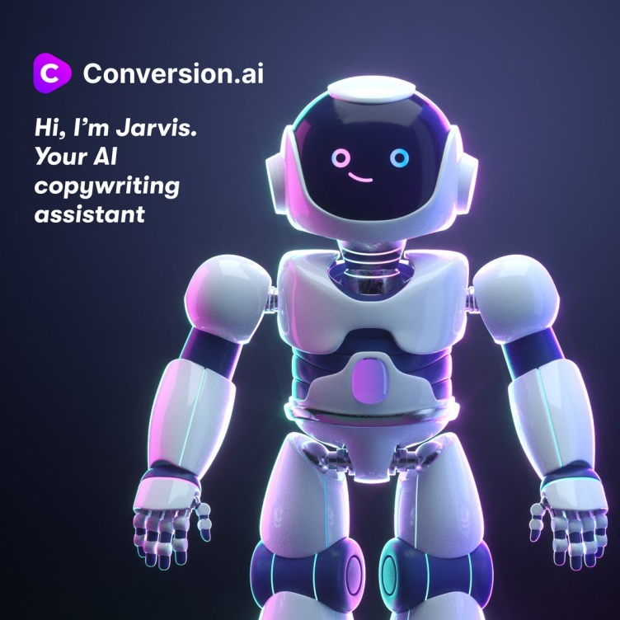
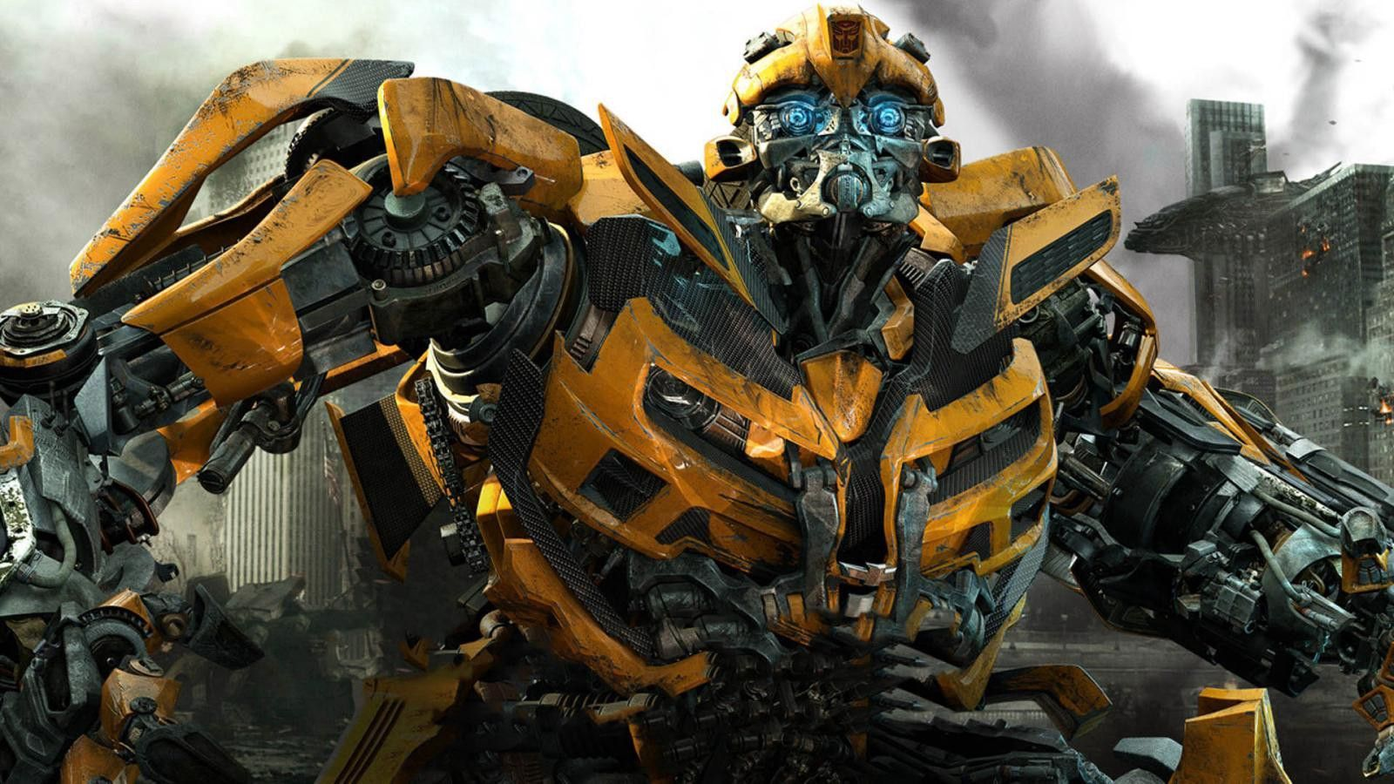
Where have you seen AI before?

Slide 3
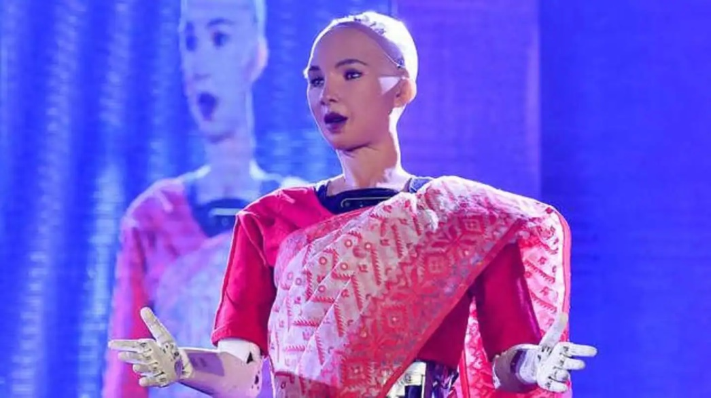
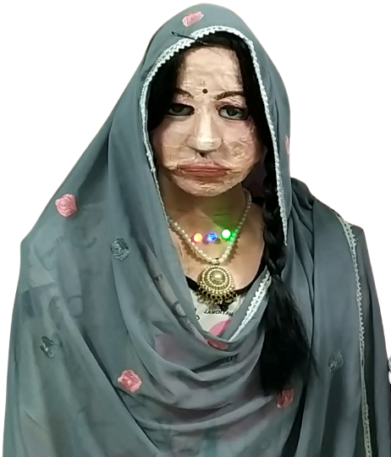
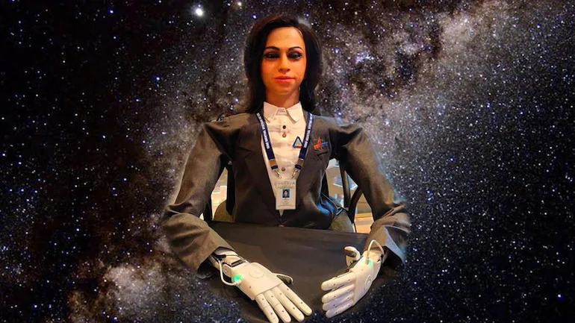
Where have you seen AI before?

Slide 4
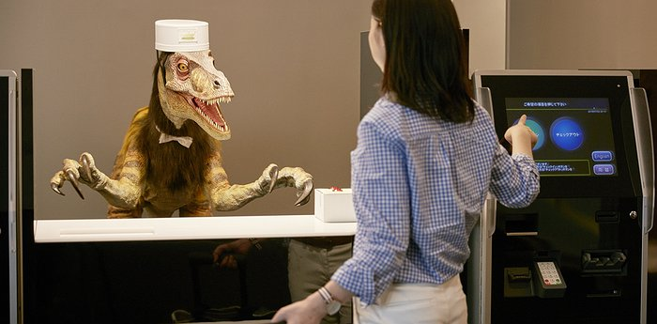
Where have you seen AI before?

Slide 5
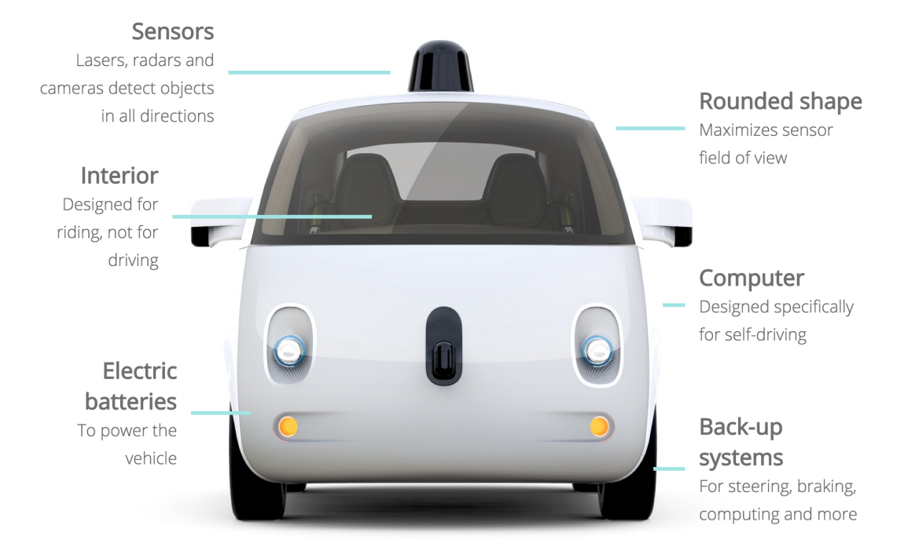

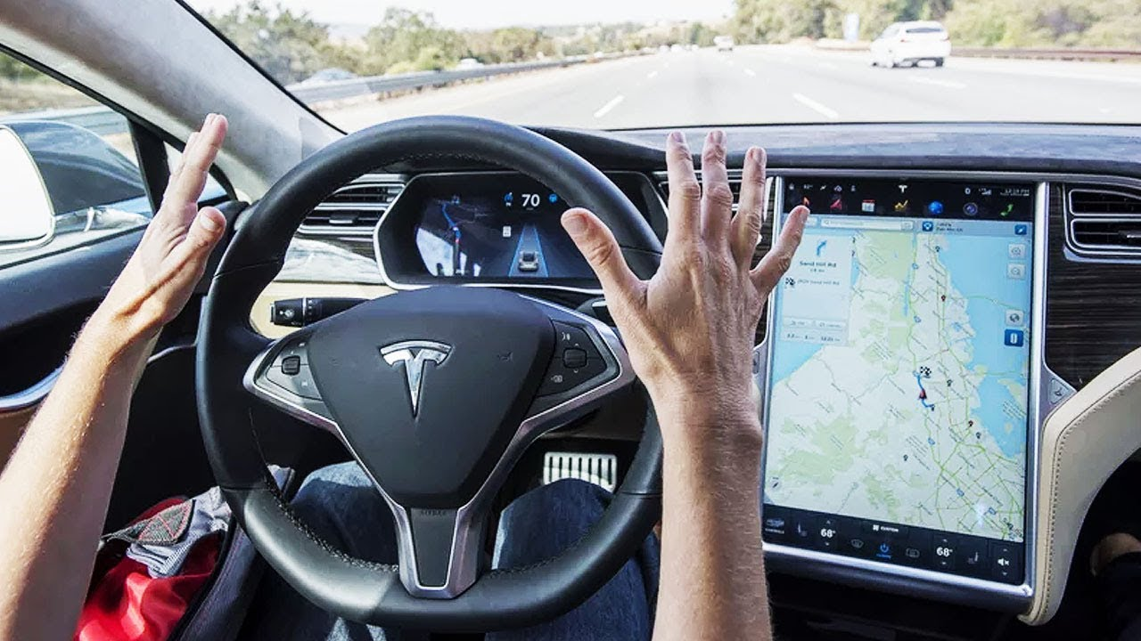
Where have you seen AI before?

Slide 6


Where have you seen AI before?

Slide 7

AI– Toy problems, games
Intelligent agents
Algorithms- searching
Knowledge representation & reasoning
Learning
Planning
Expert systems

Slide 8

Brain simulation
Cognitive architectures
Games
Knowledge and reasoning
Motion and manipulation
Natural language processing
Planning

Slide 9

Planning
Knowledge Engineering
Information retrieval
Game Theory
Expert systems
Natural language processing
Mathematics
Automation

Slide 10

Introduction to Artificial Intelligence
Intelligent Agents
Problem solving
Knowledge representation and reasoning and Reasoning
Planning and Learning
Applications: Natural Language Processing(NLP), Expert Systems.

Slide 11
Study of AI projects and Turing Test
Implementation of a PROLOG program using condition-action rules based agent
Implementation of program to solve a using Goal based agent architecture using concepts of knowledge engineering
Implementation of uninformed search algorithms
Implementation of informed search
Implementation of alpha-beta pruning
Solving planning problem using STRIPS or PDDL tools.
Implementation of Bayesian Network for Medical Diagnosis Using Python libraries.
Applications of AI in NLP

Slide 12

Collaborative Learning | This can be done in a group of max 4 students. Open book test on Agent architectures/ Model of intelligent agent. Students can use college computers on which they can download online resources, No personal laptop, tabs, mobile phones will be permitted. Internet will be disconnected during IA work.
HOTS- Study and implementation of current trends in AI | This can be done in a group of max 5 students. Choose the topic from course teacher’s repository Choose dataset given by teacher or choose your own Implement the task given Submit a plagiarism report of implemented code submit a video explaining the model of max 5 min duration

Slide 13

PROLOG
PROgramming in LOGic
JAVA, python

Slide 14
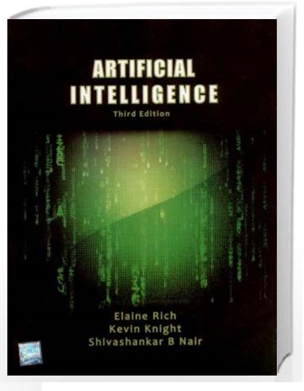
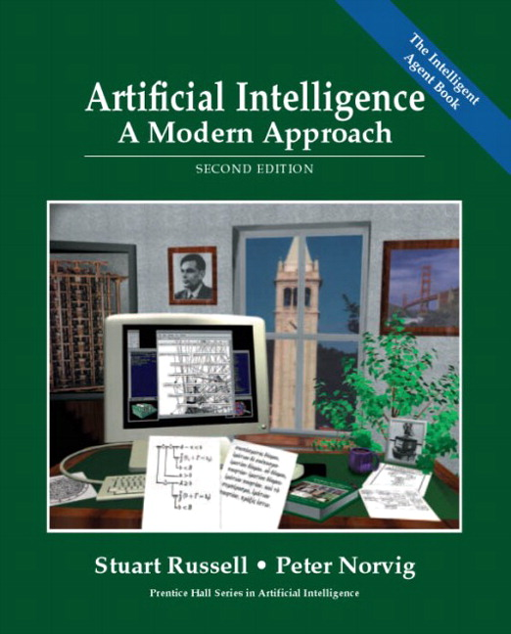
Stuart Russell and Peter Norvig, “Artificial Intelligence: A Modern Approach” Second Edition, Pearson Publication.
Allen Rich and Kelvin Knight, “ Artificial Intelligence” , third Edition, TMH

Slide 15
Teaching Learning methods
Think-pair-share
Flipped classroom
Cooperative-collaborative learning

Slide 16
Limitations of AI
HIGH COST OF IMPLEMENTATION
CAN’T REPLACE HUMANS
DOESN’T IMPROVE WITH EXPERIENCE
LACKS CREATIVITY

Slide 17
Issues with implementation
Access to Data
Bias
Computing Time
Cost
Adversarial Attacks
No Consensus on Safety, Ethics, and Privacy

Slide 18


Slide 19

Artificial Intelligence is the study of how to make computers do the things, which at the moment, people do better.
AI is concerned with designing intelligence in artificial devices.

Slide 20
What is intelligence?
Behave as intelligently as a human?
Behave in best possible manner?
Thinking?
Acting?

Slide 21

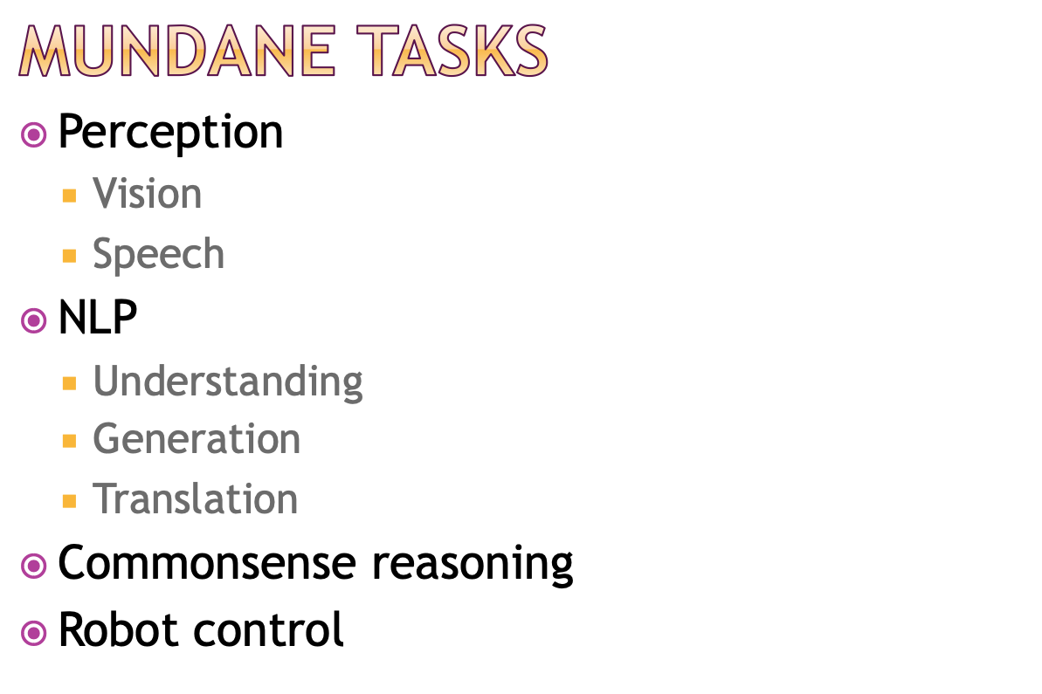

Slide 22
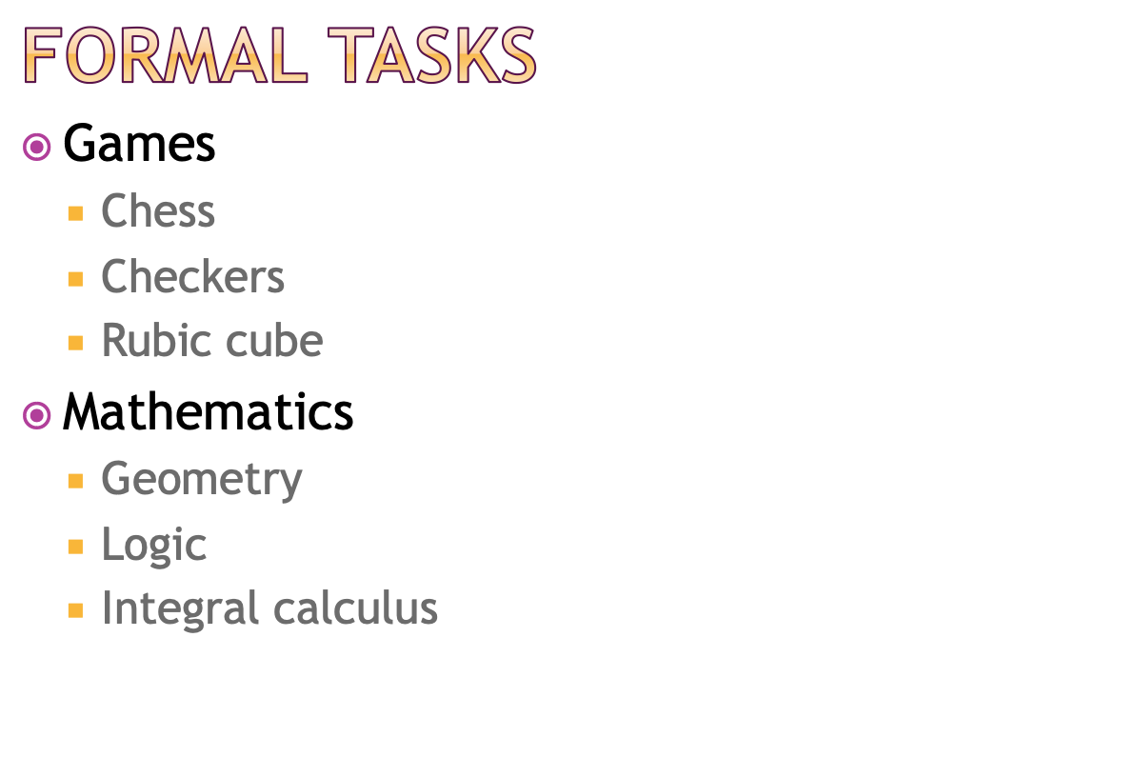

Slide 23
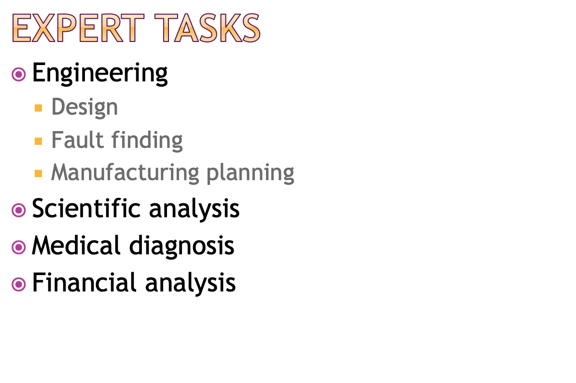

Slide 24
Limits of AI Today
Omniscient?
Clairvoyant?
General intelligence?
understanding unconstrained natural language?
Cannot surf the web yet or interpret an arbitrary visual scene.
Cannot fully learn a natural language.
Cannot construct plans in all sorts of dynamic real time domains in general.
Interpret arbitrary visual scene
Do not yet exhibit true autonomy and intelligence.

Slide 25
AI Foundations
Mathematics
Psychology
Philosophy
Artificial Intelligence
Computer Science
Economics
Biology
Linguistics

Slide 26
AI approaches & Definitions
Thought process/reasoning Vs behavior
Human like performance Vs Ideal performance
Thought / reasoning
Human like performance
Ideal performance
i.e. Rationality
Behavior

Slide 27

1. Systems that think like humans.
2. Systems that think rationally.
3. Systems that act like humans
4. Systems that act rationally

Slide 29
AI approaches & Definitions
Thought / reasoning
Think like humans
Think rationally
Human like performance
Ideal performance
i.e. Rationality
Act like humans
Act Rationally
Behavior

Slide 30
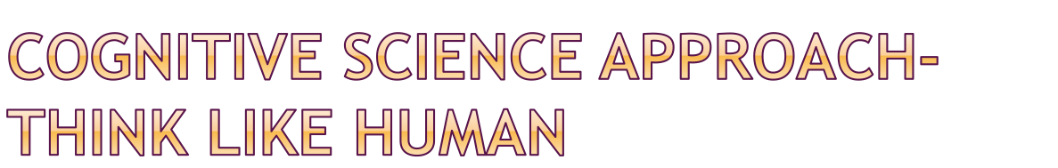
Automation of activities that we associate with human thinking
Two ways
Through introspection-trying to catch our own thoughts as they go by
Through psychological experiments
Argument: An algorithm performs well on a task and it is therefore a good model of human performance, or vice versa.

Slide 31
Thinking like human- limitations
Modern research has separated the two fields of claims: AI and cognitive science.
The two fields overlap though, especially in the areas of computer vision and natural language.

Slide 32

Study of enabling computers to do the things which require human intelligence.
The machine must have
natural language processing
knowledge representation
automated reasoning
machine learning
Total Turing Test
computer vision
robotics

Slide 33
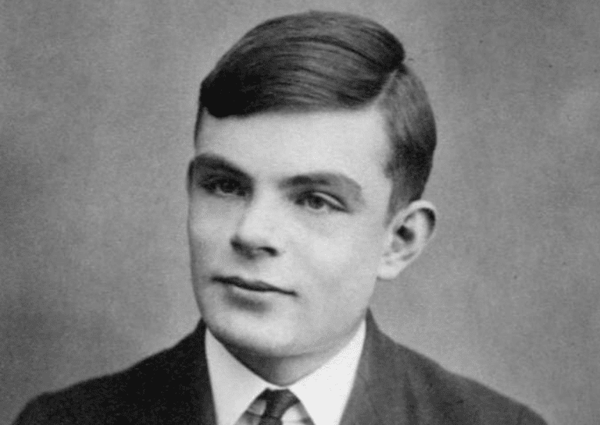
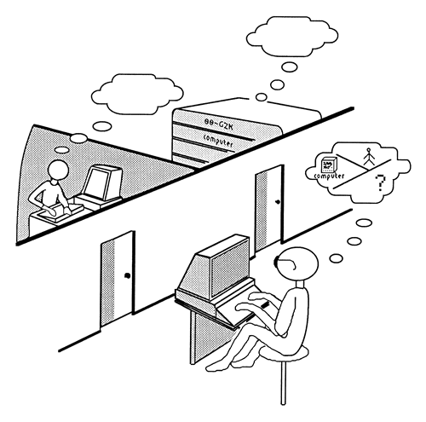
Turing Test
Courtesy: AlanTuring.net

Slide 34
Limitations – Acting like human
Mimicking human behaviour approach is not based on fundamentals on which AI could be based.
AI developers realized they didn’t need to replicate human neural processes or behavioral quirks.
They could explore broader than just acting like humans
E.g. studying aerodynamics than building machines those could fly like birds

Slide 35
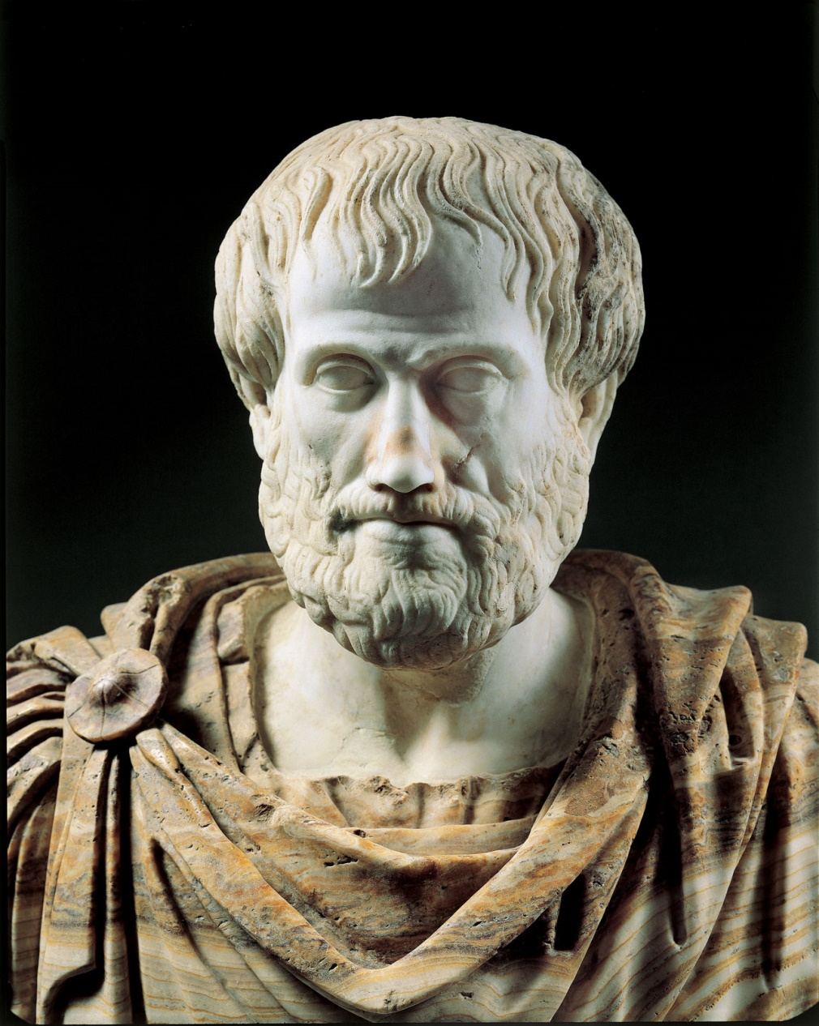
Laws of thought approach- think Rationally
Proposed by Aristotle (384-322 B.C.)
Syllogisms provides patterns for argument structures that always yield correct conclusions when given correct premises
Emphasis is on correct inferences

Slide 36
Limitations – Thinking Rationally
Problems:
Its difficult to represent informal and uncertain knowledge in formal terms required by logical notation
There is a big difference between being able to solve a problem "in principle" and doing so in practice (few facts may exhaust all computational power)

Slide 37
Act Rationally- Intelligent agent approach
Agent and Rational agent
Involves correct inferences as thinking rationally
Can suggest actions wherein no correct possible actions can be defined
Has ability to represent knowledge and reason with it to reach good decisions in a wide variety of situations
more general than the "laws of thought" approach
it is more amenable to scientific development than the approaches based on human behaviour or human thought

Slide 38
What has actually been followed?
Historically, all four approaches to AI have been followed.
A human-centered approach must be an empirical science, involving hypothesis and experimental confirmation.
A rationalist approach involves a combination of mathematics and engineering.

Slide 39
Artificial agents are NOT OMNISCIENT

Slide 40
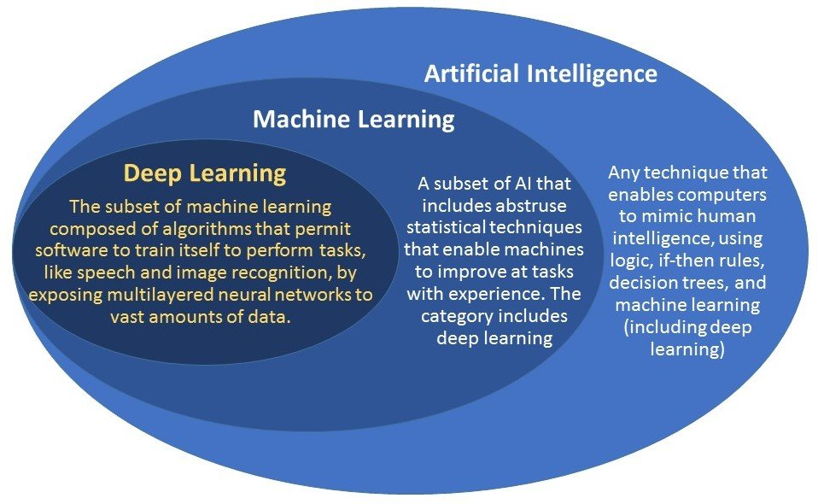

Slide 41

FIRST-ORDER Logic Language

Slide 42
Parts of Prolog program
Turbo Prolog
Swi Prolog
Domains -optional
Predicates
Clauses
Facts
Rules
Goal
Clauses (section heading is not needed)

Slide 43
Writing a prolog program
Clauses
Facts
Rules
Clauses must end with a period.
Reading a cluase
Form: Relation/verb(Subject, object,_,).
example
mother(meera, arya). – Meera is mother of Arya
now(2025). - now its 2025.
gt(25,20).- 25 is greater than 20.
type(tom,cat). – Tom’s type is cat.

Slide 44
Writing a prolog program
Facts
basic, unchanging relationships or properties in statement
form: predicate_name(arguments)
E.g. person(arya).
mother(meera, arya).
student(sushil, TY, computer,8.75)
distance(mumbai,pune,250)

Slide 45
Writing facts
Identify relationship in statement – predicate name
Identify how many arguments are needed to represent information in statement.
Identify subject, object and other attributes.
Example
man(john).
grandfather(john,jen).
Item(purse,white).
distance(mumbai,pune,250).
laptop(hp,8,i7,50000).
Do not combine multiple conditional statements into one.
Wrong: likes(meera,reading),likes(meera,hiking).
Correct:
likes(meera,reading).
likes(meera,hiking).

Slide 46
Writing a prolog program
Rules
Represent derived relationships or logic.
Generally written with variables
Form: head :- body.
where:Head: The relationship you're defining.
Body: Conditions under which the relationship is true.
Example
mother(X,Y):- female(X), parent(X,Y).
married(X,Y) :- married(Y,X).
sister(X,Y):-female(X), parent(Z,X), parent(Z,Y).

Slide 47
Data Types in Prolog
Variables and their data type declaration isn't mandatory in prolog
Types:
Symbol e.g. used for person, item etc
Integer
Float
List – like arrays
String
Boolena
Free/anonymous varibales

Slide 48
Varibales
Free variable:
not yet bound to a specific value during the execution of a query or rule.
It can match with any value, and Prolog may assign it a value during execution to satisfy the conditions of the query or rule.
Same variables can be used for different rules in same program.
Starts with an uppercase letter or an underscore (e.g., X, Person, _Variable).
Acts as a placeholder that Prolog will attempt to bind to values to satisfy goals.
If left unbound, Prolog considers it as "free" and may include it in the result of a query.

Slide 49
Free variable example
Example
female(meera).
female(arya).
mother(meera,arya).
Query: female(X)
o/p : X=meera, X=arya
Query: mother(X,arya)
o/p: X=meera

Slide 50
Anonymous variable
Always represented by an underscore (_)
is used when a value is needed for a condition but the specific value is irrelevant.
Useful for ignoring parts of a predicate or argument that are not needed for the solution
Example-
long_novel(Title) :- written_by(_, Title), book(Title, Length), Length > 300.

Slide 51
Turbo Prolog program
Swi Prolog program
likes(ellen, reading).
likes(john, computers).
likes(john, badminton).
likes(leonard, badminton).
likes(eric, swimming).
likes(eric, reading).
likes(bill, Activity) if likes(tom, Activity).
domains
name, sport=symbol
predicates
likes(name,sport)
clauses
likes(ellen, tennis).
likes(john, football).
likes(tom, baseball).
likes(eric, swimming).
likes(mark, tennis).
likes(bill, Activity) if likes(tom, Activity).

Slide 52
domains
name, sport=symbol
predicates
likes(name, sport)
clauses
likes(ellen, tennis).
likes(john, football).
likes(tom, baseball).
likes(eric, swimming).
likes(mark, tennis).
likes(bill, Activity) if likes(tom, Activity).

Slide 53
Rules
Difference between predicates and clauses (For turbo prolog)
likes(person, sports)
likes(ram, tennis).
Capitalization and free variables
Grouping of predicates/clauses
No nesting of predicates
Father(dashrath,father(kush)).

Slide 54
Rules – capitalizations
Do not capitalize first letters of arguments as they would be taken as variables.
If you wish to write in capital and wish it to be treated as constant, use quotes- “” as:
phone_number("Albert", "EZY-3665").

Slide 55
Rules - Grouping
Clauses/Statements of same predicate should be grouped together.
Example-
Write all facts and rules of person, then write all facts and rules of mother, then write all facts and rules of father etc.
Do not write one fact of person, then one of mother, then one of father, then again fact of person/mother/father etc.

Slide 56

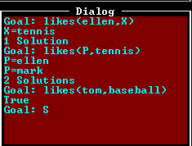

Slide 57
domains
product, sum = integer
predicates
add_em_up(sum, sum, sum)
multiply_em(product, product, product)
clauses
add_em_up(X, Y, Sum) :- Sum = X + Y.
multiply_em(X, Y, Product) :- Product = X * Y.

Slide 58


Slide 59
Rule base Vs knowledgebase programming (C/Java Vs Prolog/LISP)
 | Rule Based System | Knowledge Based System
Can Process | Data Rules | Data Rules Knowledge
Can Output | Information Decision | Information, Decision, Expert Advice, Recommendations
Commonly used for | Enterprise rules | Domain specific rules
Ideal for | Simplistic business rules | Complex business rules
Best for these types of applications | Decision Compliance | Advising, Product Selection, Recommending, Trubleshooting
Domain | Broad Logic | Deep Logic

Slide 60
Queries? Thank you!!

